Slide 1

Content: aka.ms/mkedevdays
#Azuredevdays

Slide 2


Mike Shelton - Technical Director Azure Data Services Microsoft North Central Region
https://www.linkedin.com/in/mshelt/
www.azuredevdays.com

Slide 3
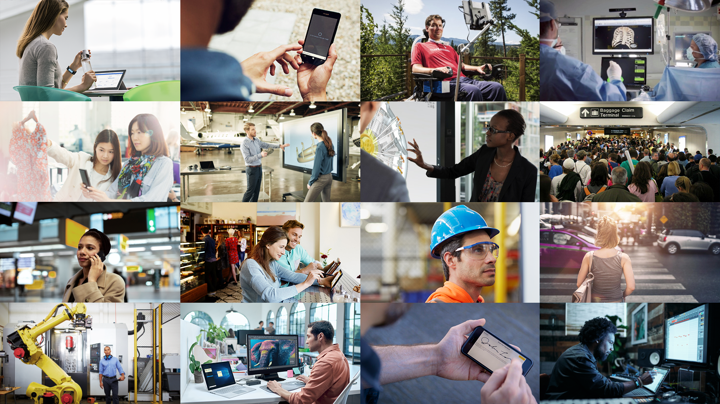
The world is changing
Notes:
We have seen many technical innovations in that past that have brought change such as the use of steam power or the introduction of electricity to mass produce things. We can also talk about the development of the Internet, and increased communication technologies increasing trade and driving economic growth.
The world is changing again.
How we work, shop, commute, and connect with others

Slide 4








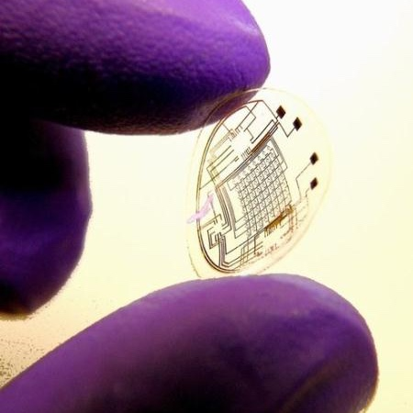
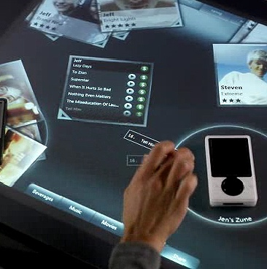
Technology trends, challenges and opportunities…
Mobile
Data
explosion
Social computing
Sensors and biometrics
Ubiquitous connectivity
Wearables
Natural UI
Notes:
What are the trends that are leading to this change.

Slide 5
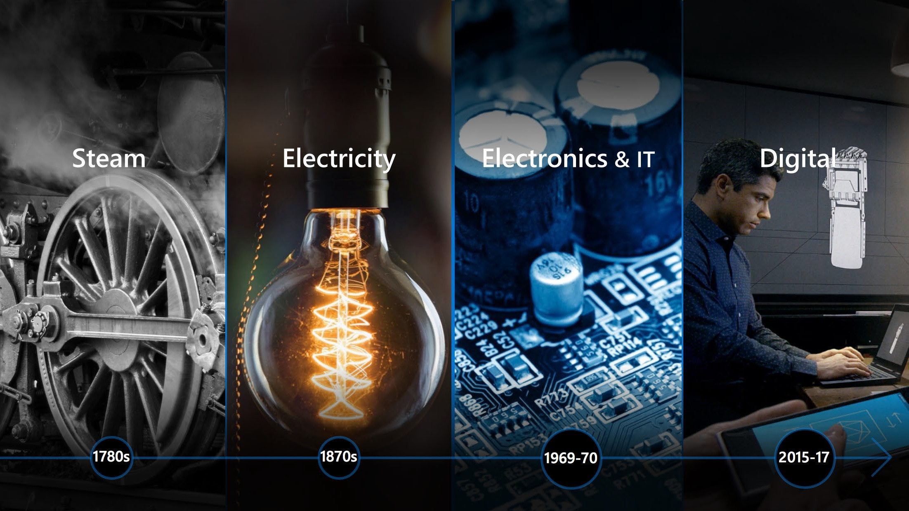
Digital Disruption and the 4th Industrial Revolution
1780s
1870s
1970s
2015+
Notes:
The change we are going through is referred to as the 4th industrial revolution. The Fourth Industrial Revolution is the concept of blurring the real world with the technological world. It is marked by emerging technology breakthroughs in a number of fields, such as robotics, artificial intelligence, blockchain, nanotechnology, quantum computing, and The Internet of Things. When compared with previous industrial revolutions, the Fourth is evolving at an exponential rather than a linear pace and it is disrupting almost every industry in every country.
It is characterized by a fusion of technologies that is blurring the lines between the physical, digital, and biological spheres.. Klaus Schwab has associated it with the "second machine age" in terms of the effects of digitization and artificial intelligence on the economy,
The Fourth Industrial Revolution will have a massive impact on society. It will impact how we work, shop, commute, and connect with others.

Slide 6
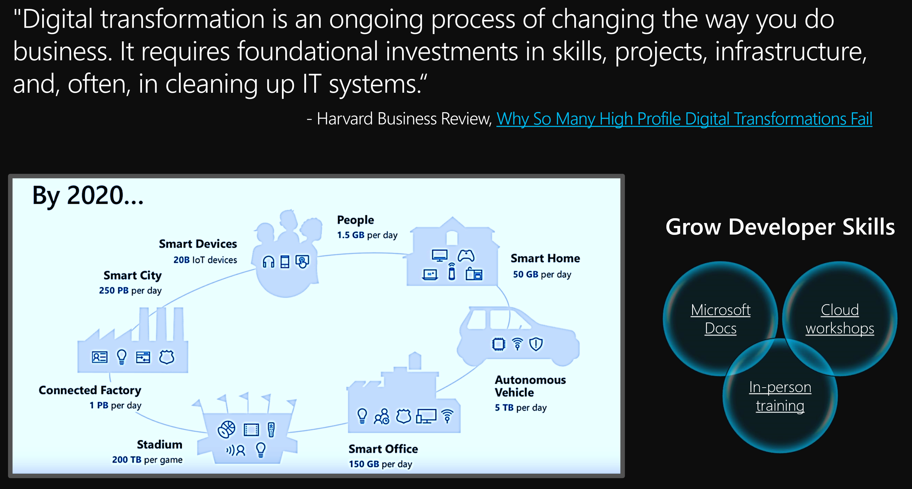

Slide 7

Driving forces behind digital transformation
DATA
163 zettabytes annually by 2025
ANALYTICS
$200 billion global market by 2020
CLOUD
Cloud shift will affect more than
$1 trillion in IT spending by 2020
Source: Forbes, Gartner
Notes:
“Data is the fuel of the digital era… is becoming more pervasive and open”
This data will span the cloud, on-premises applications and the edge of devices, requiring the ability to pull together data across disparate and diverse sources, to bring computing to where to data is, and to reason using AI in order to turn this large-scale, distributed data into intelligence.
DATA: Volumes of data continue to rise, totaling nearly 50 zettabytes by 2020 & 163 zettabytes by 2025 – that’s 20,000 times the total amount of data that existed in the world less than three decades before. The digitation of ‘things,’ heightened individual mobility and collaboration, and a host of other factors continue to accelerate data proliferation.
ANALYTICS: Advancements in data analytics and intelligence have enhanced our ability to draw value from the data – transforming information into insight that can be acted upon, even preemptively and at the point of business processes to maximize impact.
CLOUD: And the ubiquity of cloud computing puts this disruptive power in the hands of organizations of all sizes, increasing the pace of innovation and competition.
The convergence of these factors reflects technology’s omnipresent nature, where today access to digital services plays an increasing role in everything we do. And they reflect your opportunity to grow, adapt, and evolve to meet the changing needs of your customers and the new business opportunities of tomorrow by thinking and operating like a digital company.
We see the convergence of these three key trends driving digital transformtation

Slide 8
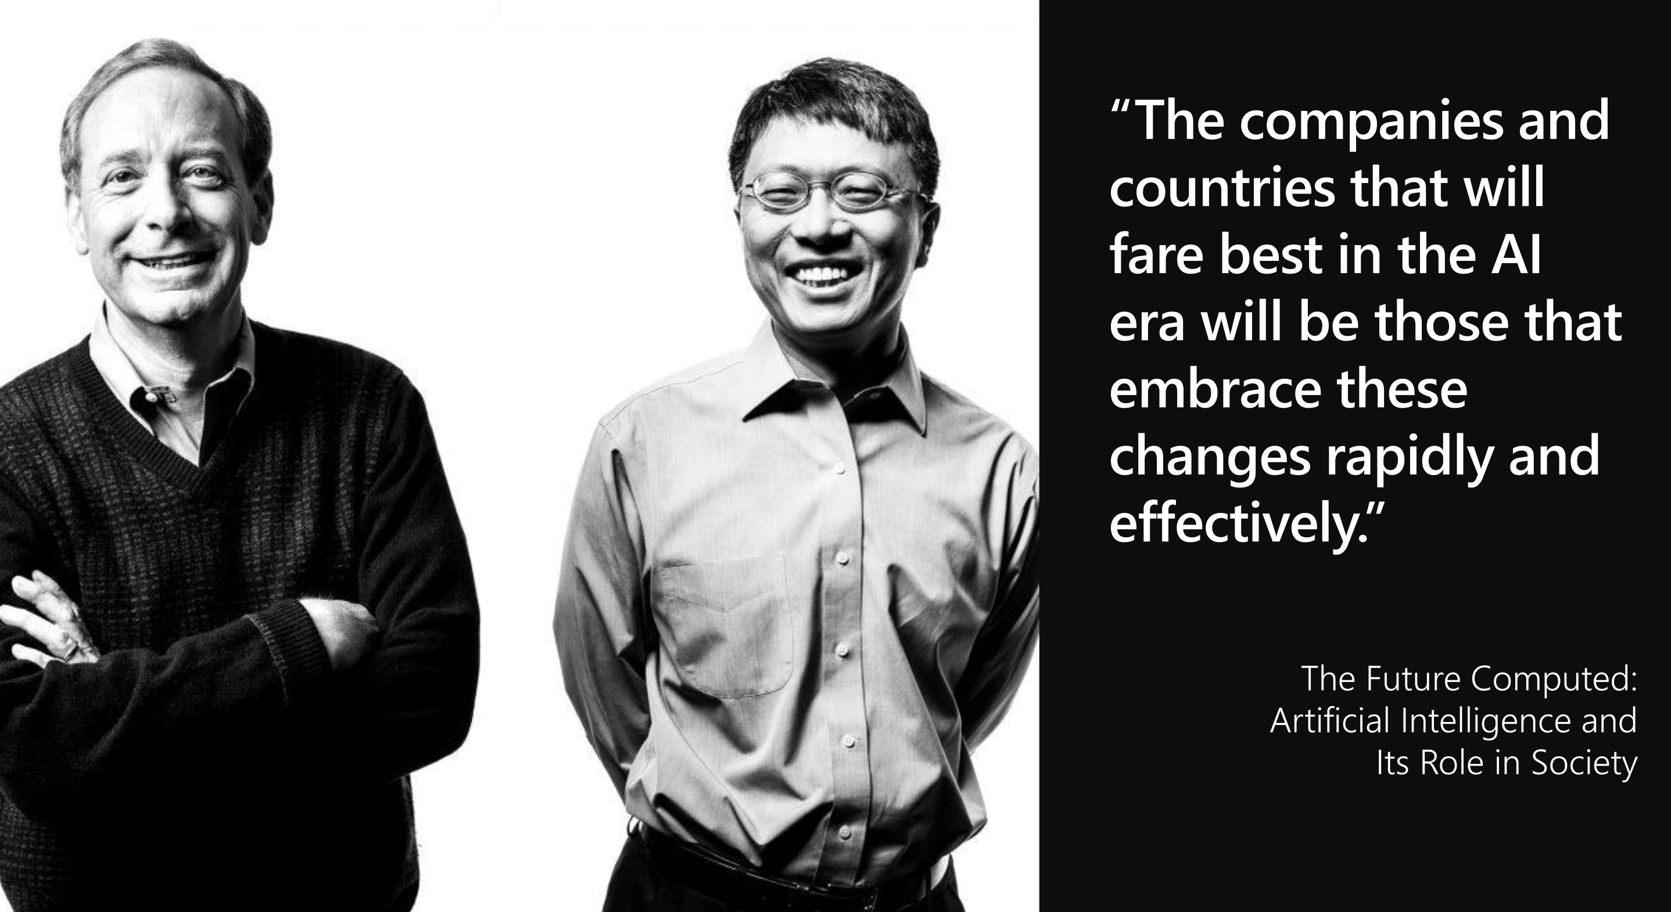

Slide 9

Our strategy is to build best-in-class platforms and productivity services for an intelligent cloud and an intelligent edge infused with artificial intelligence (“AI”).
Form 10-K 2016
Notes:
Intelligence is at the core of Microsoft’s business strategy.
First, we lead with the platform, always. We are and always will be a platform company. It’s not about the technology but rather what our customers can do with this technology to enable themselves.
Second, our platform is focused on the application pattern that will rule the applications of the future: intelligent cloud and intelligent edge. We believe compute will expand to where the data is, from massive cloud data sets all the way to where the data is created on the edge of mobile and IoT devices. It’s the concept of data gravity.
Third, all of this will be built on top of AI. First it was the PC, then the web, AI is the third runtime that every application will use in the future.
Look at the number of words in that sentence referring to intelligence… intelligent cloud, intelligent edge, artificial intelligence and AI. This is how important AI is for Microsoft.

Slide 10
Transform your business processes
85%
Enterprises embracing AI
By 2020, 85% of Enterprises will be using AI on at least one process
Financial Services
Risk Analytics
Fraud Prevention
Customer Next Best Action
Retail
Personalization
Dynamic pricing
Advanced retail planning
Manufacturing
Predictive Maintenance
Operations Automation
Fleets management
Notes:
So who is using AI today?
Today, 3 industries are at the forefront of transforming their businesses with AI – financial services, retail, and manufacturing.
In financial services – some of the scenarios where AI is being used are to analyze risk, build models for fraud prevention, predict what a customer should do next.
In retail – businesses are using AI to personalize a shopper’s experience, build dynamic pricing into their models to take environmental and circumstantial information into consideration, and also to help plan their inventory.
In manufacturing, businesses are using AI to perform predictive maintenance on machinery, automate operations, and manage their logistics.
And by 2020 85% of enterprises will be using AI.

Slide 11
Digital Agents
95%
Customer interactions
powered by AI bots including telephone and online by 2025
Engage customers
Build a loyal customer base with a 24/7 customer-centric approach to your business
Empower employees
Increase employee productivity and allow for focus on innovation by freeing up time through automation
Notes:
Conversational/Digital Agents – detail slide
By 2025, 95% of customer interactions will take place via bots. Bots are a crucial customer engagement tool to build customer loyalty and a competitive advantage for businesses
Gartner reports 60% of customer inquiries related to app dev are about bots. And the two major use cases we find are top of mind are customer service and HR
<< Microsoft differentiating factor. We have the most powerful bot platform combined with customizable Cognitive Services. Enterprises can easily build powerful agents to streamline work processes and integrate in customer’s existing data estate – whether on-premises, at the edge, in the cloud or hybrid. >>
Servion predicts that, by 2025, AI will power 95% of all customer interactions, including live telephone and online conversations that will leave customers unable to ‘spot the bot’. http://servion.com/blog/ai-will-power-95-customer-interactions-2025/

Slide 12
Intelligent apps
75%
Applications including AI
By 2018, 50% of apps will include some form of AI
App innovation
Infuse AI into existing apps to improved user experience
Knowledge extraction
Backend-infused applications will leverage latent value in content
Notes:
Intelligent apps – detail slide
Intelligent Apps is about the massive shift around developers and enterprises creating the business apps of the future built around intelligence and data
75% of apps will be infused with AI by end of 2018
Two key areas
Infusing AI into every app making them smarter, intuitive, and customized to provide better user experiences – including the ability to deploy to edge (our platform shines here)
Knowledge extraction is all about opening up new app types through AI – enabling customers to reason over unstructured organizational data, and using the power of data to reimagine applications
<< Microsoft differentiating factor: we can go big with our unique set of Cognitive Services that can be used to infuse existing and new applications for any scenario.>>

Slide 13
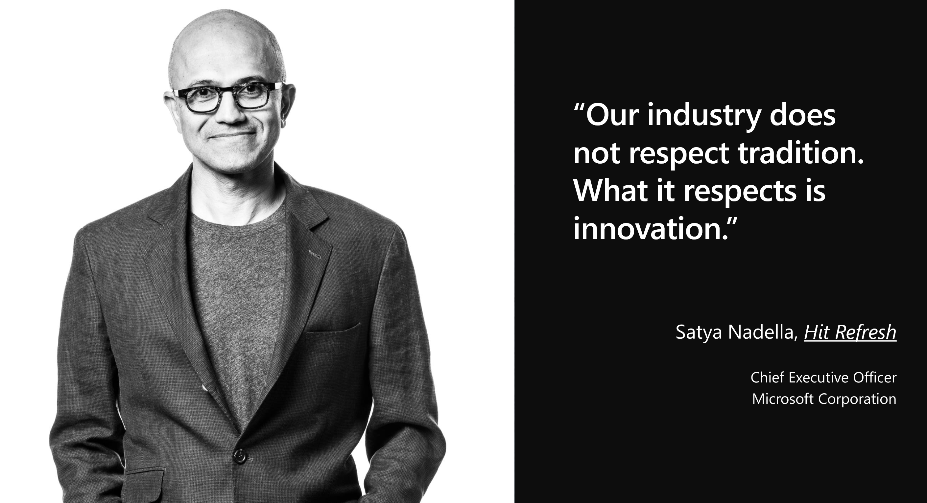

Slide 14
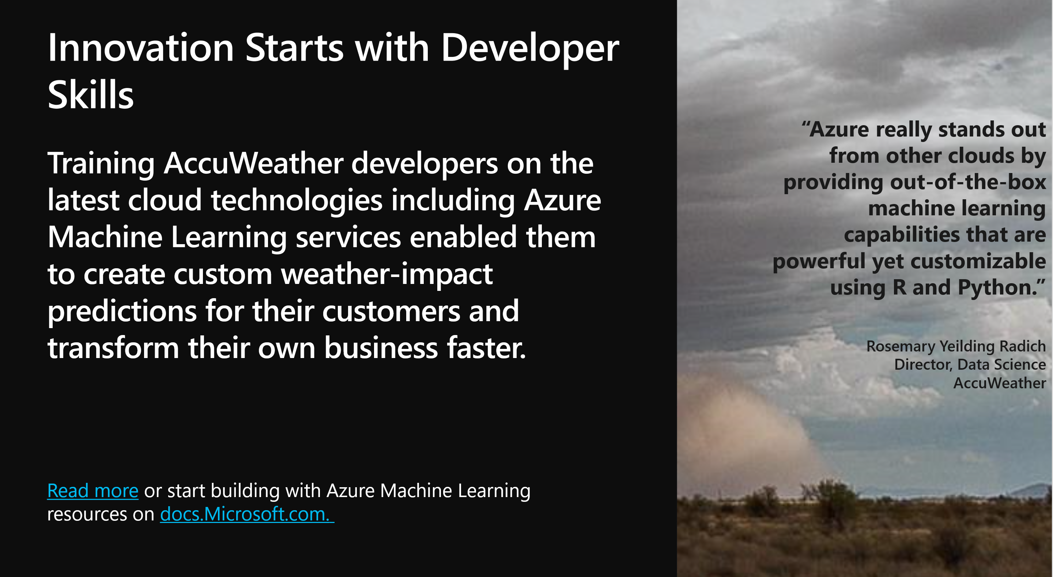

Slide 15
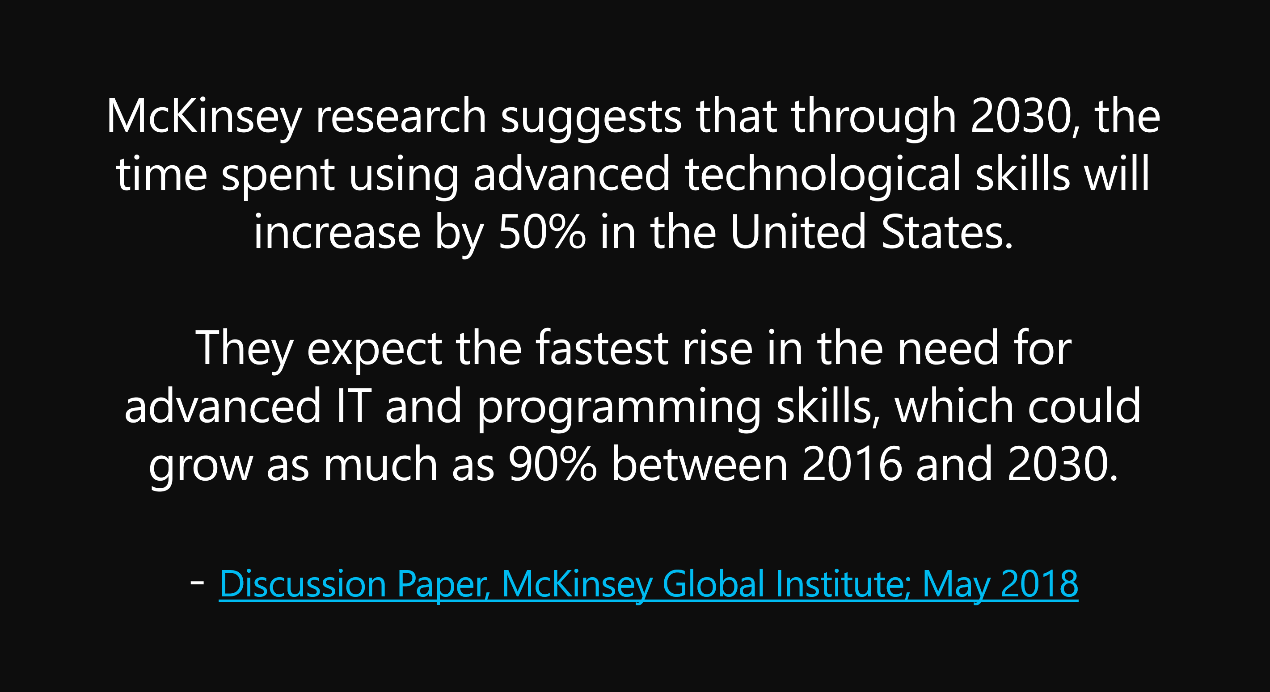

Slide 16
Agenda
Topic | Time
9:00 | Welcome Remarks
9:15 | Azure App Service
10:00 | Break
10:15 | Serverless Computing
11:00 | Break
11:15 | Microservices & Containers
12:00 | Docker
12:45 | DevOps on Azure
1:30 | Break
1:45 | Cognitive Services / Intelligent Apps
2:30 | Modern Data Stores SQL / Cosmos
3:30 – 4:30 | HOL / Whiteboard

Slide 17
Omaha Dev Days Resources
http://aka.ms/OmahaDevDays
Slides, Labs, Contact Info, Survey
Free Azure Trial
http://aka.ms/FreeAzure

